Slide 1

Network Hardware and its
Topologies
CSE306

Slide 2
Categories of Networks
Personal area networks
Local Area networks
Metropolitan Area networks
Wide Area networks
Wireless Networks
Internetworks- The Internet

Slide 3
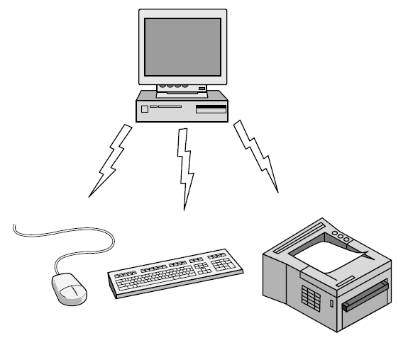
Personal Area Network
Bluetooth PAN configuration

Slide 4
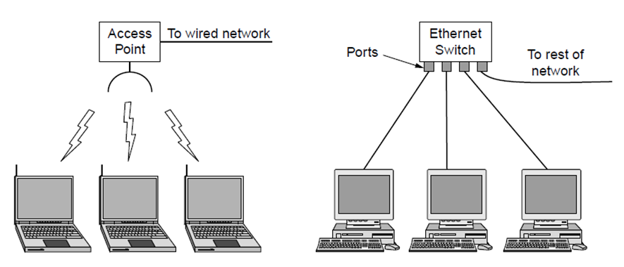
Local Area Networks (LANs)
  Short distances
  Designed to provide local interconnectivity
Wireless and wired LANs. (a) 802.11. (b) Switched Ethernet.

Slide 5

Isolated LAN connecting 12 computers to a hub in a closet
Notes:
1.#

Slide 6
Wide Area Networks (WANs)
  Long distances
  Provide connectivity over large areas

Slide 7

WANs: a switched WAN and a point-to-point WAN

Slide 8

A heterogeneous network made of four WANs and two LANs
1.<number>
Notes:
1.#

Slide 9
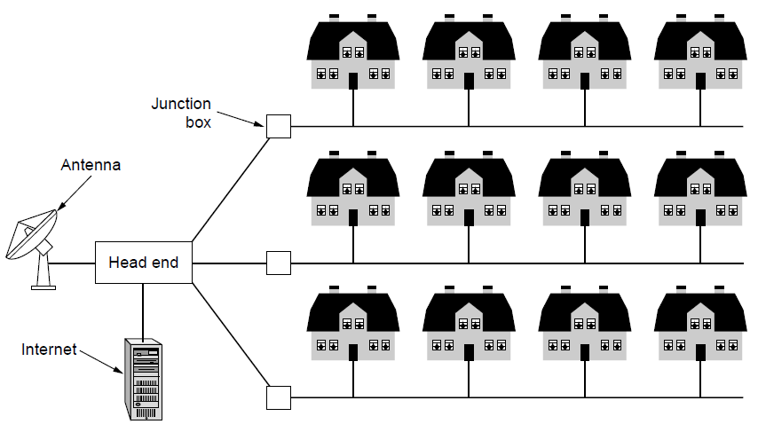
Metropolitan Area Networks (MANs)
  Provide connectivity over areas.
A MAN based on a telephone cable using DSL

Slide 10
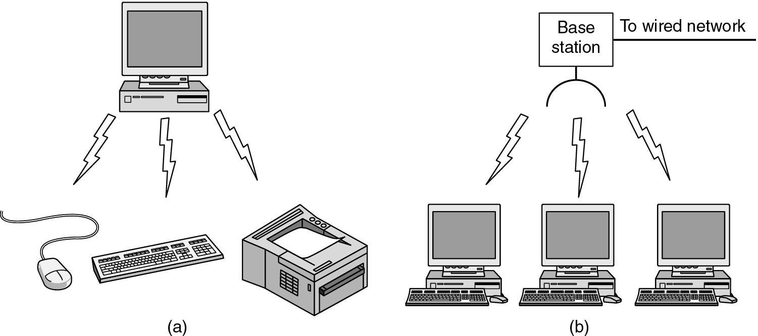
Wireless Networks
(a) Bluetooth configuration
(b) Wireless LAN

Slide 11
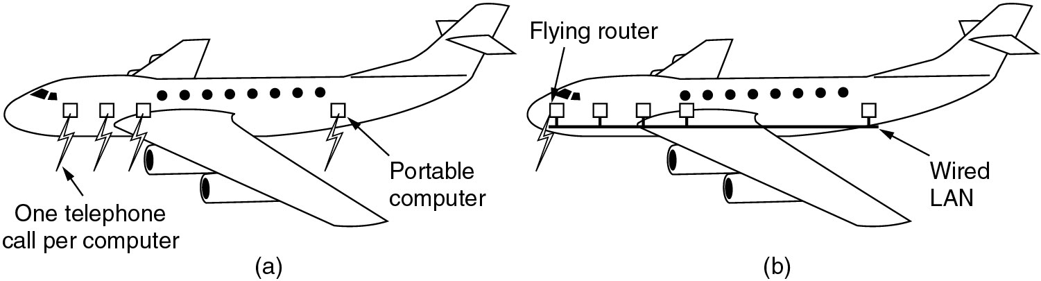
Wireless Networks
(a) Individual mobile computers
(b) A flying LAN

Slide 12
Home Network Categories
Computers (desktop PC, PDA, shared peripherals
Entertainment (TV, DVD, VCR, camera, stereo, MP3)
Telecomm (telephone, cell phone, intercom, fax)
Appliances (microwave, fridge, clock, furnace, airco)
Telemetry (utility meter, burglar alarm, babycam).

Slide 13
THE INTERNET
Connects multiple networks into one system
Transforms communication and interactions
Impacts business and daily leisure
Instant access to vast information
Information organized for easy use

Slide 14

Hierarchical organization of the Internet

Slide 15
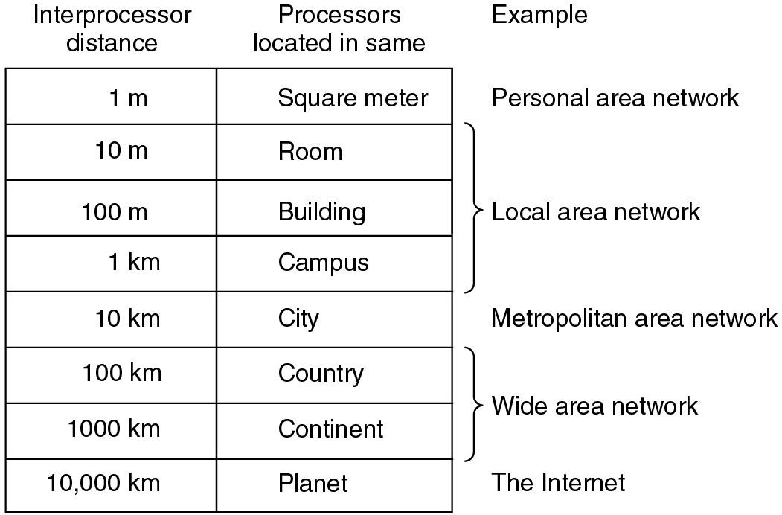
Broadcast Networks
Classification of interconnected processors by scale.

Slide 16
Network Topology
Defines how network nodes connect
Physical topology: cabling layout
Logical topology: data flow path
Physical = device connections
Logical = signal movement
Structure affects performance
Notes:
The topology of a network defines how the nodes of a network are connected.
The shape of the cabling layout used to link devices is called the physical topology of the network.
The logical topology, in contrast, is the way that the signals act on the network media, or the way that the data passes through the network from one device to the next without regard to the physical interconnection of the devices.

Slide 17
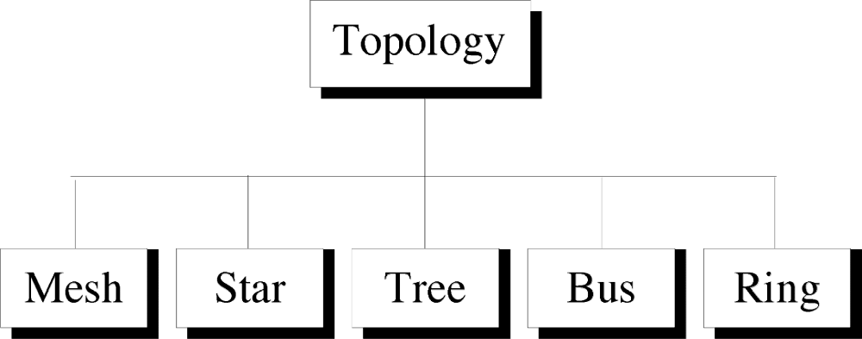
Categories of Physical Topology

Slide 18
Mesh Topology
Every device linked to all others
Point-to-point connections used
Each node connects to n-1 nodes
Fully connected: n(n-1)/2 links
Needs n-1 I/O ports per node
High cost but robust

Slide 19

A fully connected mesh topology (five devices)
1.<number>
Notes:
1.#

Slide 20
Advantages of Mesh
Dedicated links avoid traffic issues
Robust: one link failure won’t affect others
High privacy and security
Easy fault detection and isolation

Slide 21
Disadvantages of Mesh
Requires large cabling
Needs many I/O ports
Wiring bulk may exceed space
High hardware cost
Expensive to install and maintain

Slide 22
Applications of Mesh
Telephone Regional office.
WAN.(Wide Area Network).

Slide 23
Star Topology
Devices connect to a central hub
Hub acts as an exchange
No direct device-to-device traffic
All data passes through the hub
Hub relays messages to target device
Notes:
Here each device has a dedicated point-to-point link to the central controller called “Hub”(Act as a Exchange).
There is no direct traffic between devices.
The transmission are occurred only through the central “hub”.
When device 1 wants to send data to device 2; First sends the data to hub. Which then relays the data to the other connected device.

Slide 24

Star Topology

Slide 25
Advantages of Star Topology
Less expensive than mesh.
Installation and configuration are easy.
Less cabling is needed compared to mesh.
Robustness.
Easy fault identification.
No disruptions when connecting/removing devices
Notes:
Less expensive then mesh since each device is connected only to the hub.
Installation and configuration are easy.
Less cabling is need then mesh.
Robustness.(if one link fails, only that links is affected. All other links remain active)
Easy to fault identification & to remove parts.
No distruptions to the network then connecting(or) removing devices.

Slide 26
Disadvantages of Star Topology
More cabling than ring or bus topology.
Central dependency
Notes:
Even it requires less cabling then mesh when compared with other topologies it still large.(Ring or bus).
Dependency(whole n/w dependent on one single point(hub). When it goes down. The whole system is dead.

Slide 27
Applications of Star Topology
Star topology is used in LAN
High-speed LAN often uses STAR.

Slide 28
Bus Topology
Multipoint configuration:
One long cable acts as the backbone.
Connections:
1. Drop line 2. Tap
Limitation:
Only one device can transmit at a time.
Notes:
A bus topology is multipoint.
Here one long cable act as a backbone to link all the devices are connected to the backbone by drop lines and taps.
Drop line- is the connection b/w the devices and the cable.
Tap- is the splitter that cut the main link.
This allows only one device to transmit at a time.

Slide 29

Bus Topology

Slide 30
Data Transmission
Device sends, data flows both ways
Terminators stop signal reflection back
All devices monitor cable messages
Recipient reads, others ignore message
Shared cable needs transmission control
Prevents collisions between multiple devices
Notes:
When a device sends a message, it is broadcast down on the cable in both directions. Terminators at the end of the cable prevent the signal from reflecting back to the sender.
All devices on the cable constantly monitor for messages meant to them. When a device detects a message meant for it, it reads the message from the cable and the other devices will ignore it.
Since all devices are sharing the same cable, some form of control is needed to make sure which device will transmit when, otherwise there will be a collision.

Slide 31
Advantages of Bus Topology
Ease of installation.
Less cabling.
less expensive.

Slide 32
Disadvantages of Bus Topology
Difficult reconfiguration and fault isolation.
Difficult to add new devices.
Signal reflection at top can degradation in quality.
If any fault in backbone can stops all transmission.

Slide 33
Applications of Bus Topology
Most computer motherboard.

Slide 34
Ring Topology
Each device connects to two others
Signal flows one direction through devices
Each device contains a repeater
Repeater regenerates and forwards signals
Adding/removing changes only two links
Simple structure with easy maintenance
Notes:
Here each device has a dedicated connection with two devices on either side.
The signal is passed in one direction from device to device until it reaches the destination and each device have repeater.
When one device received signals instead of intended another device, its repeater then regenerates the data and passes them along.
To add or delete a device requires changing only two connections.

Slide 35

Ring Topology

Slide 36
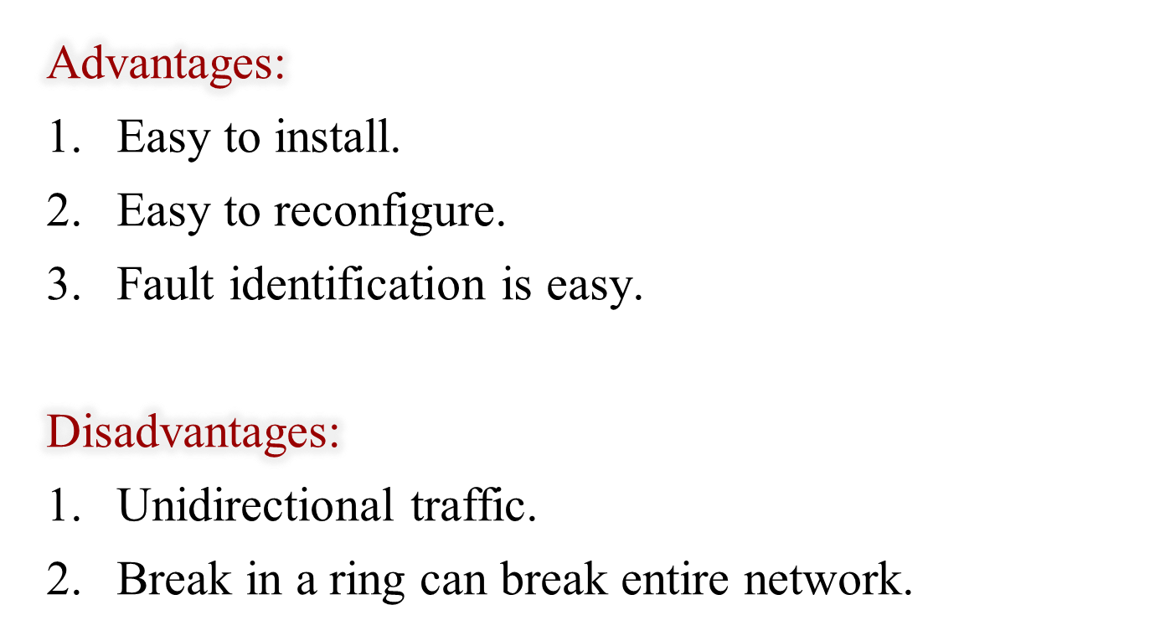
Ring Topology

Slide 37
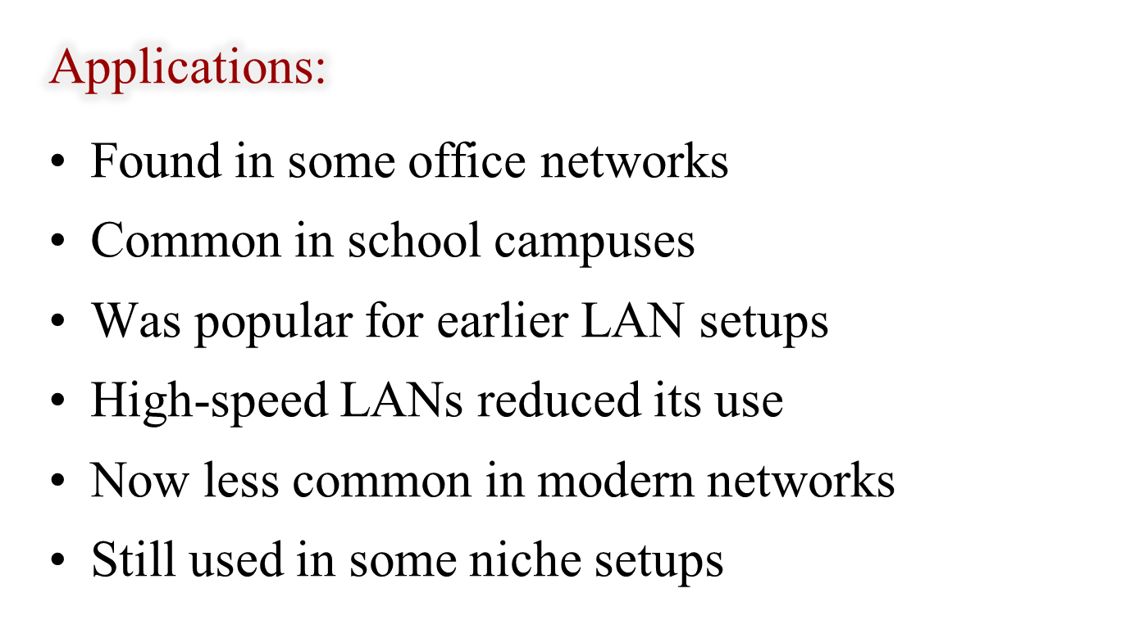
Ring Topology

Slide 38
Tree Topology
Also called star-bus topology
Combines features of bus and star
Common in many network setups
Connects multiple star networks together
Links stars to other star networks
Allows scalable and flexible design
Notes:
Alternatively referred to as a star bus topology.
Tree topology is one of the most common network setups that is similar to a bus topology and a star topology.
A tree topology connects multiple star networks to other star networks. Below is a visual example of a simple computer setup on a network using the star topology.

Slide 39
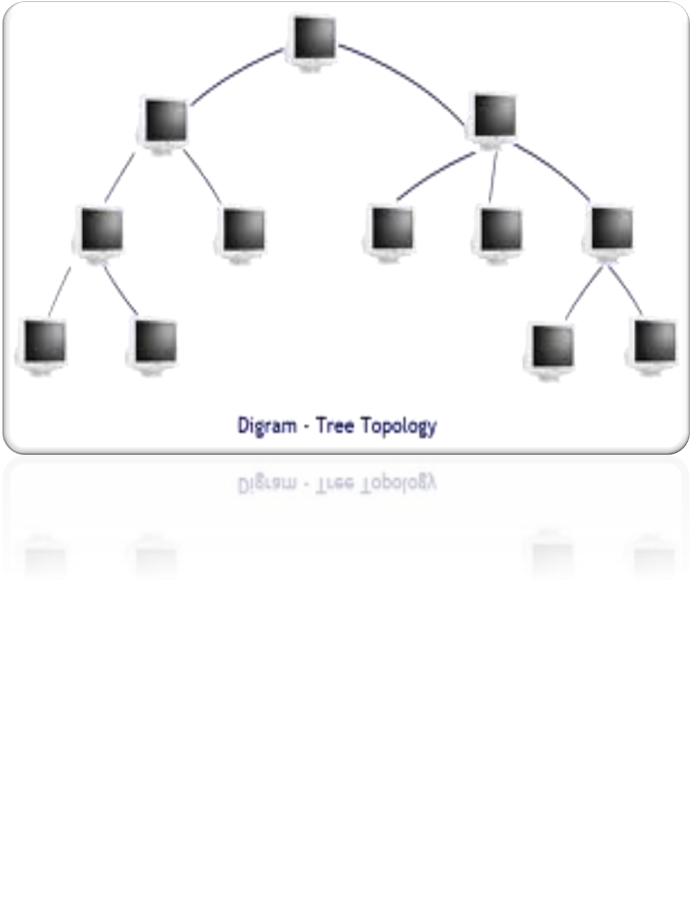

Slide 40
Hybrid Topology
Combines multiple physical network types
All structures connect under one system
Uses a single backbone channel
Flexible and customizable network design
Can mix star, bus, ring, mesh
Common in large, complex networks

Slide 41
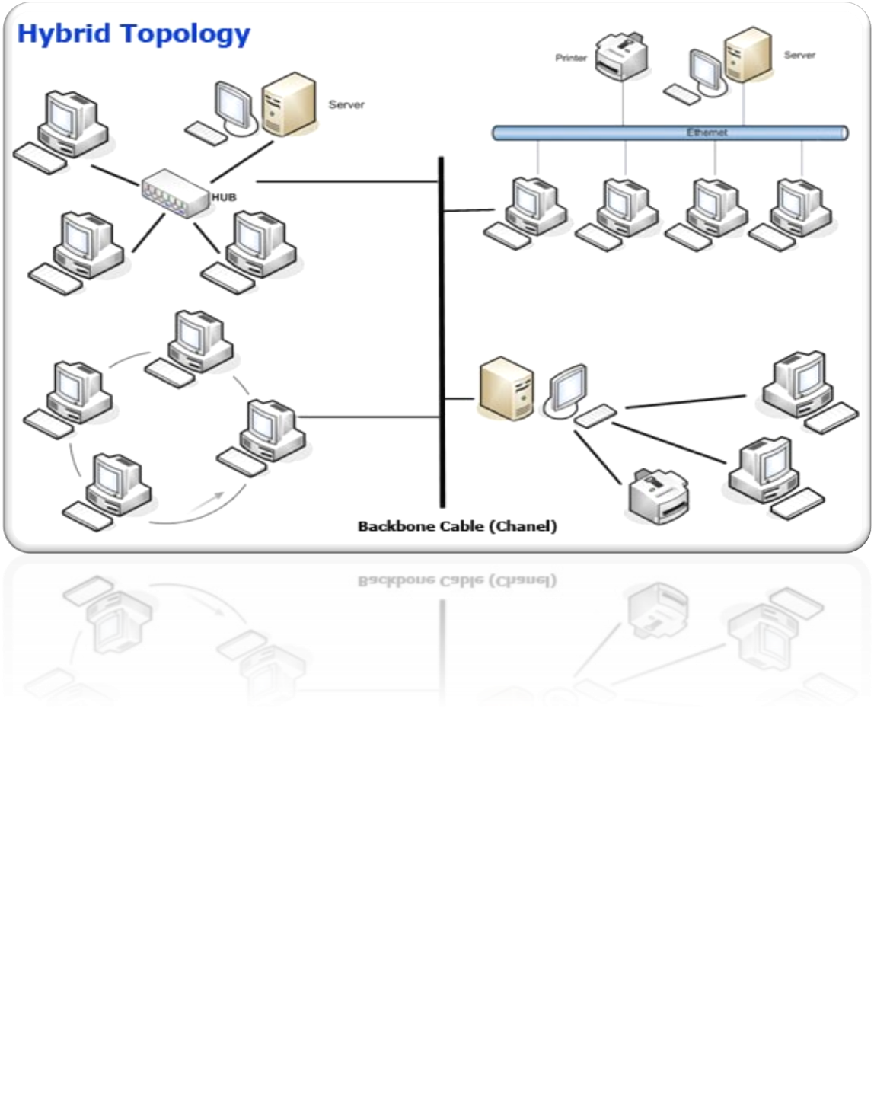

Slide 42

Hybrid Topology

Slide 43
Considerations for Choosing Network Topology
Bus networks are least expensive
    Linear bus uses shorter cable lengths
Star topology allows easy expansion
    Add devices to grow the network

Slide 44
Contd.
Full mesh gives max speed, security
    Every device links to all others
    Very expensive to install, maintain
Tree topology is next best
    Tree = multiple stars connected together
    Balances performance and cost

Slide 45
Backbone Networks: Serial Backbone
Linked series of connected devices
Extends network using hubs or switches
Includes hubs, routers, gateways, bridges
Notes:
Daisy chain: linked series of devices
Hubs and switches often connected in daisy chain to extend a network
Hubs, gateways, routers, switches, and bridges can form part of backbone
Extent to which hubs can be connected is limited

Slide 46
Puzzle : Match the Topology to Its Description
Topology | Description
A) Mesh | 1) Every device has a point-to-point connection
B) Star | 2) All devices connect to a central hub
C) Bus | 3) Devices connect to a single backbone cable
D) Ring | 4) Data travels in one direction using repeaters

Slide 47
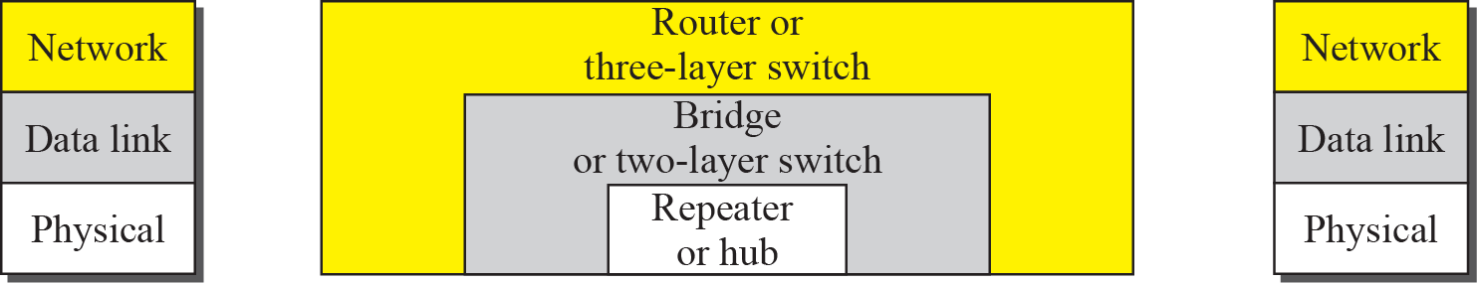
Connecting devices

Slide 48
Repeater or Hub
Broadcasts data to all devices
Causes more network collisions
Connects devices in same network
Works at Physical layer only
No filtering or traffic control
Simple, low-cost device

Slide 49
Switch
Intelligent network connecting device
Learns device MAC addresses automatically
Forwards data to correct destination
Works at Data Link layer
Uses MAC addresses for decisions
Improves efficiency over hubs

Slide 50
Router
Connects different types of networks
Performs routing of data packets
Uses IP addresses for decisions
Directs traffic to correct destination
Works at Network layer
Key device for Internet access

Slide 51
Puzzle : Match the Device to Its Function
Device | Function
A) Hub | 1) Broadcasts data to all ports
B) Switch | 2) Learns MAC addresses and forwards intelligently
C) Router | 3) Routes data between networks
D) Repeater | 4) Regenerates signal

